Slide 1

Investigation of Heat Transfer Behaviour of a Radiator Using Nanofluid As a Coolant
Bundelkhand Institute of Engineering and Technology , Jhansi ( 284128 )
Presenting by - Under the Supervision of –
Shishant Kumar Vimal(2004340039) Dr. Nagendra Prasad Yadav
Yogank Yadav(2004340047) (Professor & HOD)
Mechanical Engineering Department

Slide 2
CONTENTS
Introduction
Literature review
Objective
Experimental setup and procedure
Results and discussion
Conclusion
References

Slide 3
INTRODUCTION
In recent years, advancements in engineering and technology have led to an increased demand for efficient cooling solutions in various applications, including automotive, industrial, and electronic systems.
Heat transfer plays a pivotal role in maintaining the optimal operating conditions of these systems, as excess heat can lead to performance degradation, component failure, and reduced overall efficiency.
Traditional coolants, such as water, have limitations in their ability to effectively dissipate heat, especially when facing the challenges posed by high heat fluxes and compact designs.
To address these challenges, researchers and engineers have turned their attention to nanofluids as a promising alternative coolant solution.

Slide 4
NANOFLUIDS
Nanofluids are a new class of nanotechnology-based heat transfer fluids, obtained by dispersing and stably suspending nanoparticles with typical dimensions on the order of 10 nm.
Nanofluids (Nanoparticle fluid suspensions) is the term coined by Choi (1995) to describe this new class of nanotechnology-based heat transfer fluids with augmented thermal properties, both superior to the properties of their own hosting fluids and the conventional particle fluid suspensions.
The goal of nanofluids is to achieve the highest possible thermal properties at the smallest possible concentrations (preferably<1% by volume) by uniform dispersion and stable suspension of nanoparticles (preferably<10 nm) in host fluids. To achieve this goal it is vital to understand how nanoparticles enhance energy transport in liquids.

Slide 5
CLASSIFICATION OF NANOFLUIDS
The classification of nanofluids is based on the type of nanoparticles chosen for nanofluid production. In general, the nanofluids can be classified into four different groups, which are
Metal-based nanofluids- Metal-based nanofluids are prepared by suspending metal nanoparticles such as gold, silver, aluminium, etc., in a base fluid.
metal oxide-based nanofluids- the metal oxide nanoparticles, titania (TiO₂) and alumina (Al₂O₃) are the most commonly used nanoparticles to synthesis metal oxide-based nanofluids.
carbon-based nanofluids- Carbon-based nanofluids are made of ND, graphene, and CNT, etc.,
mixed/hybrid metal-based nanofluids-mixing various nanoparticles into base fluids to create what are now known as “hybrid nanofluids.

Slide 6
ROLE OF NANOFLUIDS IN HEAT TRANSFER
Nanofluids leverage the unique properties of nanoparticles to enhance heat transfer and fluid dynamics. The interaction between nanoparticles and the base fluid leads to improved thermal performance.
Mechanisms Behind Nanofluid Heat Transfer
Enhanced Thermal Conductivity: Nanoparticles have high thermal conductivities compared to the base fluid. Heat is transferred more effectively from higher-conductivity nanoparticles to the fluid.
Increased Surface Area: Nanoparticles have large surface areas relative to their volume. This increases the contact area between nanoparticles and fluid molecules, promoting heat exchange.

Slide 7
Boundary Layer Reduction: Nanofluids disrupt the thermal boundary layer near heat transfer surfaces. This reduction enhances convective heat transfer by maintaining a steep temperature gradient.
Altered Flow Behavior: Nanoparticles can influence fluid viscosity and flow characteristics. Modified flow behavior leads to improved mixing and convective heat transfer.

Slide 8
APPLICATIONS OF NANOFLUIDS IN HEAT TRANSFER
Cooling Systems:- Nanofluids are utilized as coolants in radiators. Enhanced heat transfer leads to improved engine cooling efficiency. Reduced risk of engine overheating and enhanced vehicle performance.
Electronics and Computer Cooling:- Nanofluids dissipate heat in high-power electronics. Improved cooling of computer chips and electronic components. Increased reliability and lifespan of electronic devices.
Solar Thermal Systems:- Nanofluids enhance heat absorption in solar collectors. Improved energy conversion efficiency in solar power generation. Higher utilization of solar energy for heating and electricity production.

Slide 9
Heat Exchangers:- Nanofluids enhance the efficiency of heat exchangers. Increased thermal conductivity promotes more efficient heat transfer. Potential for compact and more effective heat exchanger designs.

Slide 10
LITERATURE REVIEW
Godson et.al.(2010)
This paper explores the effect of nanofluids on heat transfer in radiators. The authors conducted experimental investigations with varying concentrations of nanoparticles dispersed in the coolant fluid. The results indicated a substantial increase in heat transfer coefficient and enhanced overall cooling performance. This study laid the foundation for the concept of utilizing nanofluids as an innovative coolant solution.
Murshed et.al.(2014)
the authors provide an overview of the key areas of nanofluids including thermophysical and heat transfer properties of carbon nanotube and magnetic nanofluids, viscosity of metal oxide nanofluids and pool boiling of nanofluids.

Slide 11
Che Sidik et.al.(2015)
The study conducted by Che Sidik employs computational fluid dynamics (CFD) simulations to analyze the behavior of nanofluids within radiator systems. The authors investigate flow patterns, temperature distribution, and pressure drop in comparison to traditional coolants. The simulation results reveal intricate details about how nanofluids influence the heat transfer process and provide insights into designing efficient radiator configurations.
Shirvan et.al.(2017)
the authors provide an overview of nanofluids, their properties, and their applications in cooling systems. The paper discusses the mechanisms behind enhanced heat transfer in nanofluids, including improved thermal conductivity and altered flow behavior. The potential benefits of using nanofluids in radiators for automobiles are highlighted, shedding light on their ability to mitigate overheating issues.
Pandya et.al.(2020)
This paper provides a broad perspective on the use of nanofluids for heat transfer enhancement. The paper discusses various nanoparticles, base fluids, and their impacts on thermal conductivity and convective heat transfer. The authors address the challenges and future prospects of utilizing nanofluids in heat exchangers and radiators, setting the stage for further investigation in this field.

Slide 12
Mert et.al.(2021)
the researchers designed and tested a radiator using nanofluid as the coolant. They evaluated the cooling efficiency, pressure drop, and thermal performance under different operating conditions. The findings showcase the potential of nanofluids to enhance the overall heat dissipation capabilities of radiators, demonstrating their applicability in real-world scenarios.
Ajeeb et.al.(2023)
In this experimental investigation, Al2O3-water nanofluids were used as coolants in a plate heat exchanger. The researchers measured heat transfer rates and pressure drops for different nanofluid concentrations and flow rates. The results indicated a considerable enhancement in heat transfer compared to the base fluid. However, challenges related to nanoparticle sedimentation and stability were highlighted, suggesting the need for careful consideration in practical applications.

Slide 13
SUMMARY
The literature review on the investigation of heat transfer behavior of radiators using nanofluids as coolants reveals a growing body of research focused on enhancing the thermal performance of cooling systems. Nanoparticles in a base fluid, have gained considerable attention due to their potential to improve heat transfer characteristics compared to traditional coolants.
The potential benefits of using nanofluids in radiators for automobiles are highlighted, shedding light on their ability to mitigate overheating issues.
The paper provides an overview of the critical aspects of nanofluids, focusing on their significance in mechanical engineering applications..
The study aims to assess the feasibility and effectiveness of employing nano fluid-based coolants for improving the overall efficiency of automotive cooling systems.

Slide 14
AIM & OBJECTIVE
This investigation aims to systematically study the heat transfer behavior of a radiator when utilizing nano fluids as the coolant. The primary objectives of this study include:
Fabrication of experimental setup for experimental analysis
Conduction of experiment for the analysis of the change in temperature behaviour with respect to different concentration of nano fluid.
Conducting experimental studies to assess the heat transfer enhancement achieved by using nano fluids compared to traditional coolants.

Slide 15
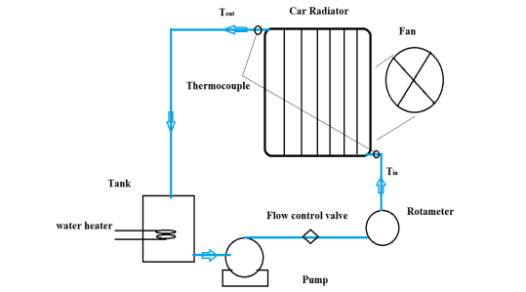
EXPERIMENTAL SETUP AND PROCEDURE
Heat transfer take place between the coolant and surrounding through the radiator fin with the help of radiator fan.
Fig1:-Schematic diagram of an experimental setup

Slide 16
the schematic representation of the experimental facility with a radiator for examining the heat transfer enhancement.
This experimental setup contains a radiator, reservoir tank, an electric heater, a pump, a rotameter, heat transfer fluid (HTF) tubes, control valves, a fan and a DC power supply.
Control valves were used for measuring and regulating the mass flow rate. All HTF tubes were insulated for avoiding heat loss from the surface of the tubes to the surrounding.
The nanofluid in the tank is heated up to the required temperature and the pump is turned ON permitting the nanofluid to flow over the car radiator and simultaneously the coolant fan is turned ON to absorb the heat from the nanofluid and accordingly dissipate to the atmosphere.
Measuring the temperature at radiator inlet.
Fluid passes through radiator for cooling.
Measuring the temperature at exit of radiator.
The fluid moves to the reservoir again.
Repeat the previous steps with different concentration, flowrate and tempreature.

Slide 17
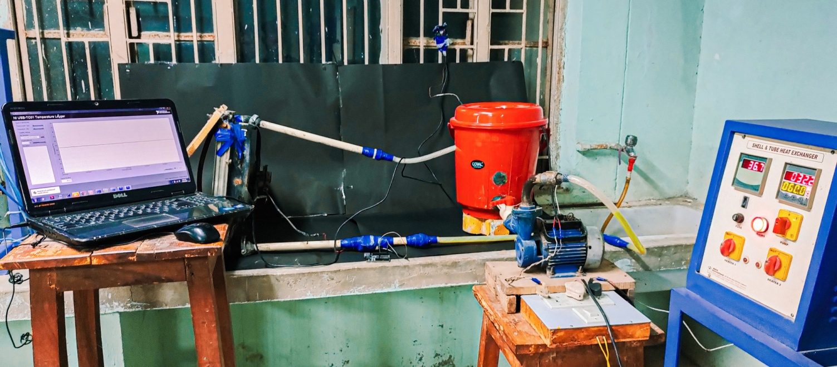
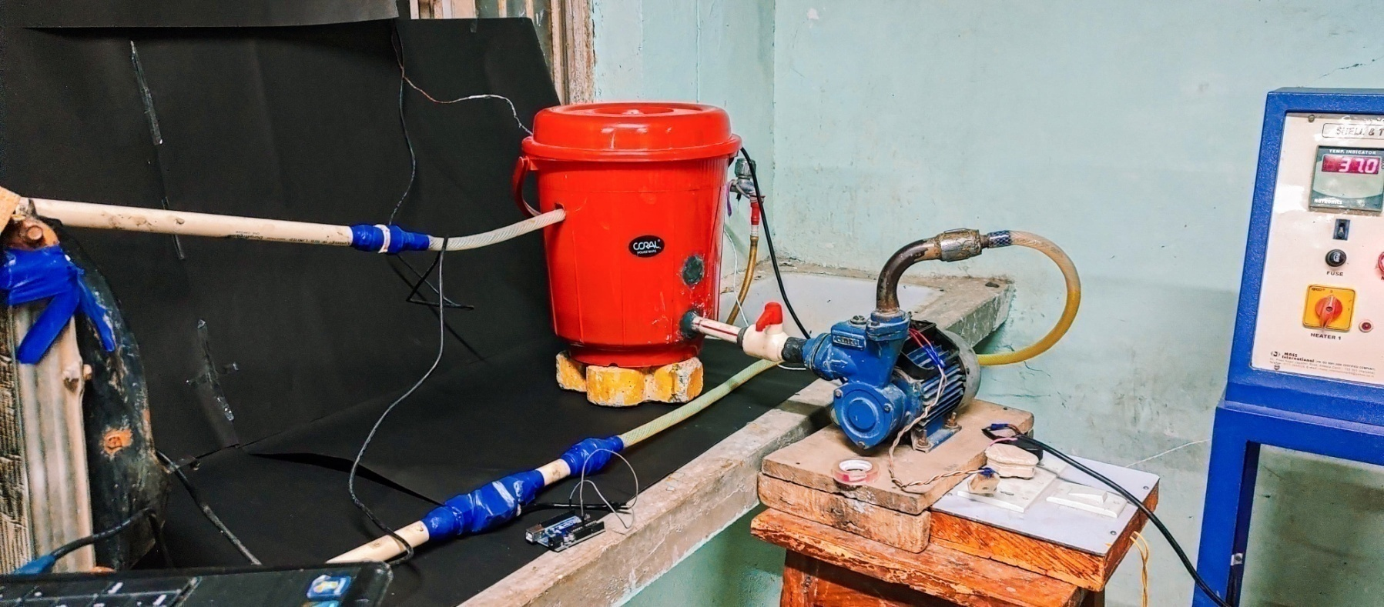
Temperature output
Temperature Input

Slide 18


Radiator
Storage Tank
Temperature output
Water pump
outlet
Water flow sensor
Inlet
Fig 2. Experimental Set up

Slide 19
SPECIFICATION
Component | Specification
Radiator | Maruti, single pass cross flow type radiator, Capacity 3.5 liter.
Water Flow Sensor | Maximum 30 lpm.
Heater | 220 V AC, 3000 W
Pump | Continuous duty, 220 V, 50 H_{Z}, 0.5 HP, 0.373 W
Tubes | Heat Resistant PVC Pipes
Storage Tank | Plastic Bucket
Thermocouple | Dip type, Digital temperature sensor
Arduino | Microcontroller board based on the ATmega328P

Slide 20
THERMOPHYSICAL PROPERTIES OF FLUID
Thermo physical properties | Base fluid (Water) | Nanofluid (Ethylene glycol) | Nanofluid with 10%conc. | Nanofluid with 20%conc. | Nanofluid with 30%conc.
Density (kg/m³) | 1000 | 1090 | 1009 | 1018 | 1027
Specific heat (j/kg-k) | 4186 | 4145 | 4105.031 | 3984.78 | 3871.408
Conductivity (w/m-k) | 0.5548 | 0.687 | 0.618 | 0.635 | 0.649

Slide 21
MATHEMATICAL FORMULA
Heat transfer through the water
Heat transfer through the nanofluid
Density
𝜌_{nf} = ∅𝜌_{nf} + (1−∅)
Specific Heat
𝜌∁_{𝑝})_{nf} = ∅(𝜌∁_{𝑝})_{p} + (1 − ∅) (𝜌∁_{𝑝})_{w}

Slide 22

Thermal Conductivity
where ρ_{nf}, Cp_{nf} and k_{nf} are known as density, specific heat and thermal conductivity of nanofluid; ϕ stands for volumetric concentration of coolant; ρ_{p}, Cp_{p} and k_{p} are the density, specific heat and thermal conductivity of coolant and ρ_{w}, Cp_{w} and k_{w} are the density, specific heat and thermal conductivity of water.

Slide 23
Table 1 – Water (for temperature, flow rate and heat transfer rate)
Flow Rate (LPM) | T in (°C) | T out (°C) | Q (w)
2.07 | 40 | 38.5 | 213.486
4.12 | 40 | 38.9 | 313.1128
5.90 | 40 | 39.2 | 328.1824
8.08 | 40 | 39.3 | 392.6468
2.07 | 45 | 40.8 | 597.7608
4.12 | 45 | 41.6 | 967.8032
5.90 | 45 | 42.25 | 1128.127
8.08 | 45 | 42.5 | 1402.31
2.07 | 50 | 43.55 | 917.9898
4.12 | 50 | 44.35 | 1608.261
5.90 | 50 | 45 | 2051.14
8.08 | 50 | 45.5 | 2524.158
2.07 | 55 | 45.5 | 1352.078
4.12 | 55 | 46.6 | 2391.043
5.90 | 55 | 47.15 | 3220.29
8.08 | 55 | 47.85 | 4010.607

Slide 24
Table 2 -Nanofluid with 10% Concentration(for temperature, flow rate and heat transfer rate)
Flow Rate (LPM) | T in (°C) | T out (°C) | Q (w)
2.07 | 40 | 37.95 | 277.7053
4.12 | 40 | 38.15 | 501.2243
5.90 | 40 | 38.6 | 540.2221
8.08 | 40 | 38.8 | 640.3848
2.07 | 45 | 39.85 | 697.65
4.12 | 45 | 41.3 | 1002.449
5.90 | 45 | 41.5 | 1350.555
8.08 | 45 | 42 | 1600.962
2.07 | 50 | 42.1 | 1070.182
4.12 | 50 | 43.05 | 1882.978
5.90 | 50 | 43.8 | 2392.412
8.08 | 50 | 44.3 | 3041.828
2.07 | 55 | 43.1 | 1612.046
4.12 | 55 | 44.2 | 2926.066
5.90 | 55 | 45.45 | 3685.086
8.08 | 55 | 46.75 | 4402.646

Slide 25
Table 3 -Nanofluid with 20% Concentration(for temperature, flow rate and heat transfer rate)
Flow Rate (LPM) | T in (°C) | T out (°C) | Q (w)
2.07 | 40 | 36.6 | 447.0923
4.12 | 40 | 37.3 | 710.0878
5.90 | 40 | 37.9 | 786.5956
8.08 | 40 | 38.4 | 828.8342
2.07 | 45 | 38.5 | 854.7353
4.12 | 45 | 39.2 | 1525.374
5.90 | 45 | 39.7 | 1985.217
8.08 | 45 | 40.1 | 2538.305
2.07 | 50 | 41 | 1183.48
4.12 | 50 | 41.9 | 2130.263
5.90 | 50 | 42.8 | 2696.899
8.08 | 50 | 43.2 | 3522.546
2.07 | 55 | 42.3 | 1670.021
4.12 | 55 | 43 | 3155.946
5.90 | 55 | 43.6 | 4270.09
8.08 | 55 | 44.1 | 5646.433

Slide 26
Table 4 -Nanofluid with 30% Concentration(for temperature, flow rate and heat transfer rate)
Flow Rate (LPM) | T in (°C) | T out (°C) | Q (w)
2.07 | 40 | 34.3 | 728.2118
4.12 | 40 | 35.3 | 1200.911
5.90 | 40 | 36 | 1455.649
8.08 | 40 | 36.5 | 1761.491
2.07 | 45 | 37 | 1022.052
4.12 | 45 | 37.9 | 1814.142
5.90 | 45 | 38.7 | 2292.648
8.08 | 45 | 39 | 3019.698
2.07 | 50 | 39.9 | 1290.34
4.12 | 50 | 40.8 | 2350.719
5.90 | 50 | 41.3 | 3166.037
8.08 | 50 | 41.8 | 4126.921
2.07 | 55 | 41.4 | 1737.488
4.12 | 55 | 42.4 | 3219.463
5.90 | 55 | 42.9 | 4403.339
8.08 | 55 | 43.3 | 5888.412

Slide 27
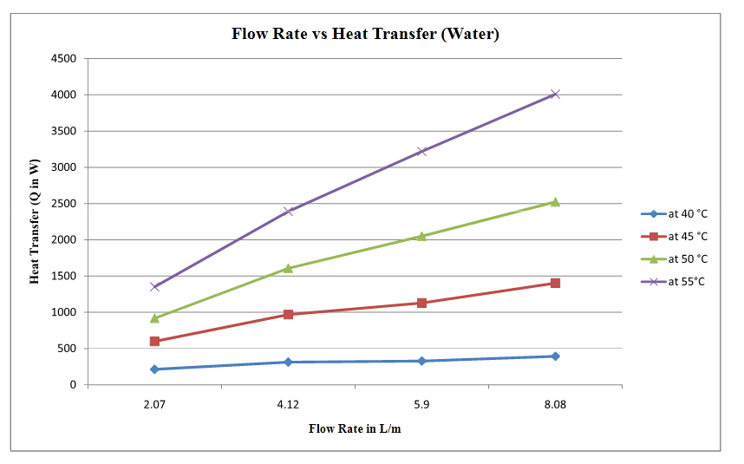
Result & Discussion
Fig 3. Flow Rate vs Heat Transfer (water)
The variation of heat transfer rate from the radiator with coolant flow rate at different engine temperature is given in Fig. 3
With the increase in flow rate, the heat transfer rate increases for pure water at different temperatures because the mass flow rate of water increases with increasing the flow rate. So the heat transfer rate directly depends on the flow rate.

Slide 28
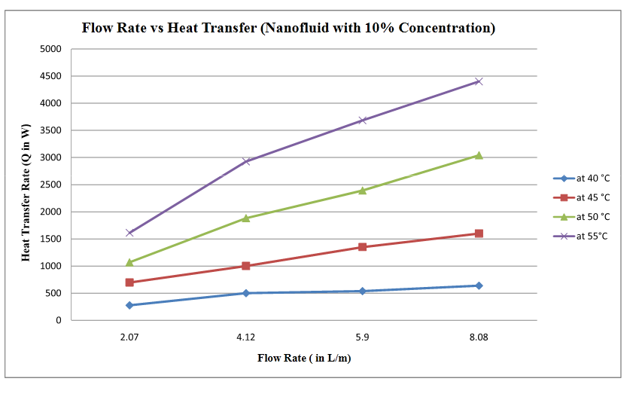
Fig 4. Flow Rate vs Heat Transfer (Nanofluid with 10% conc.)
Fig 4. shows the variation in heat transfer rate at different flow rate with different engine temperature in 10% concentration nanofluid. With the increase in flow rate, the heat transfer rate increases for nanofluid with a 10% concentration because the mass flow rate of coolant increases with increasing the flow rate. So the heat transfer rate directly depends on the flow rate. The maximum heat transfer rate was found at 55°C.

Slide 29
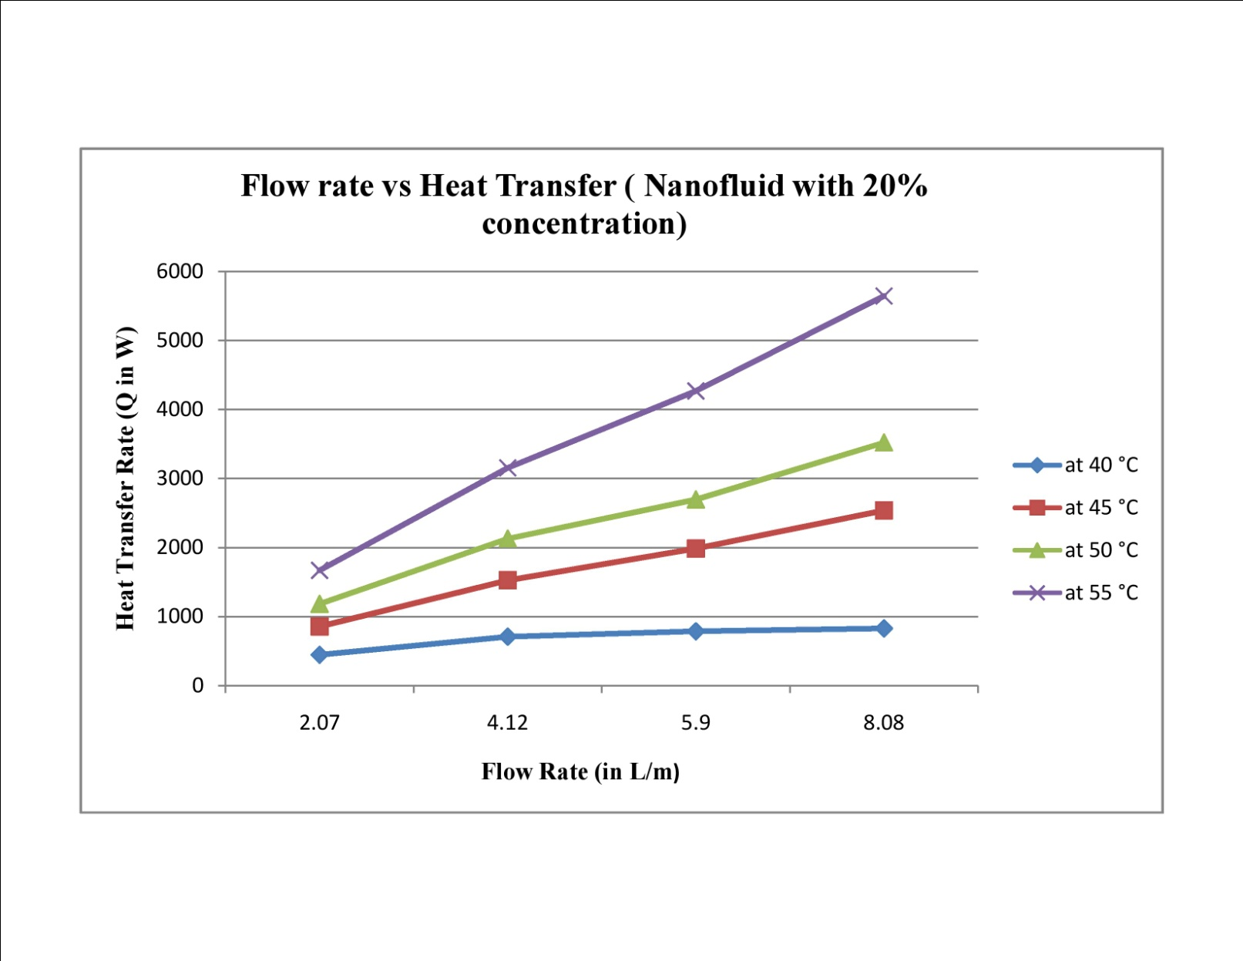
Fig 5. Flow Rate vs Heat Transfer (Nanofluid with 20% conc.)
Fig 5 shows the variation in heat transfer rate at different flow rate with different engine temperature in 20% concentration nanofluid. With the increase in flow rate, the heat transfer rate increases for nanofluid with a 20% concentration because the mass flow rate of coolant increases with increasing the flow rate. So the heat transfer rate directly depends on the flow rate. The maximum heat transfer rate was found at 55°C.

Slide 30
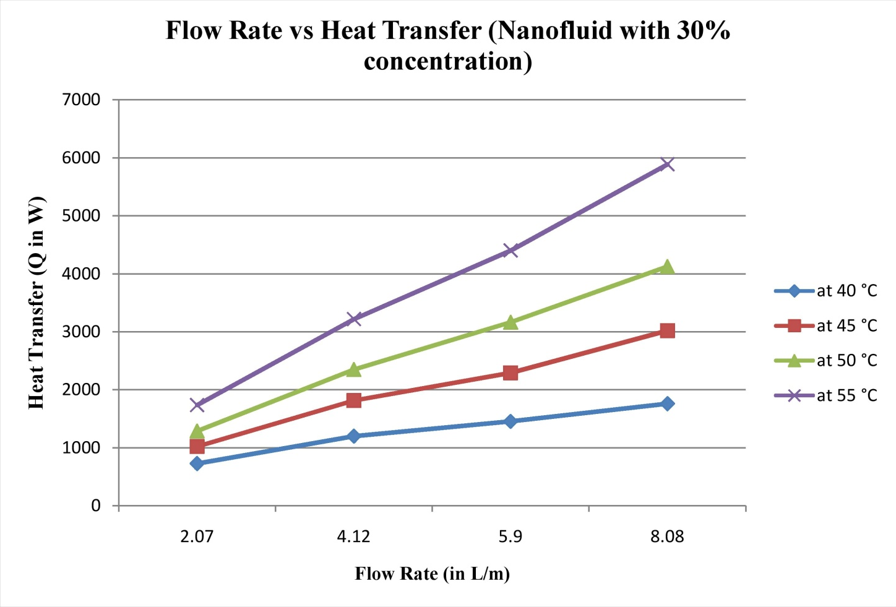
Fig 6. Flow Rate vs Heat Transfer (Nanofluid with 30% conc.)
The variation of heat transfer rate from the radiator with coolant flow rate at different engine temperature is given in Fig. 6. With the increase in flow rate, the heat transfer rate increases for nanofluid with a 30% concentration. So the heat transfer rate directly depends on the flow rate. The maximum heat transfer rate was found at 55°C

Slide 31
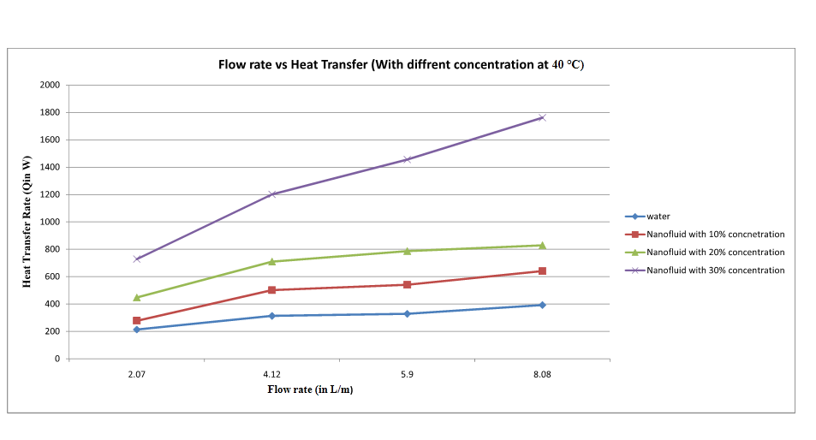
Fig 7. Flow Rate vs Heat Transfer (with different conc. At 40°C)
Fig 7 relates between flow rate and heat transfer rate and shows variation of heat transfer rate with different flow rate at different concentrations of nanofluid. With Increase in different concentration and flow rate, heat transfer rate also increases at fixed temp 40°C. In the graph nanofluid is having better heat transfer rate.

Slide 32
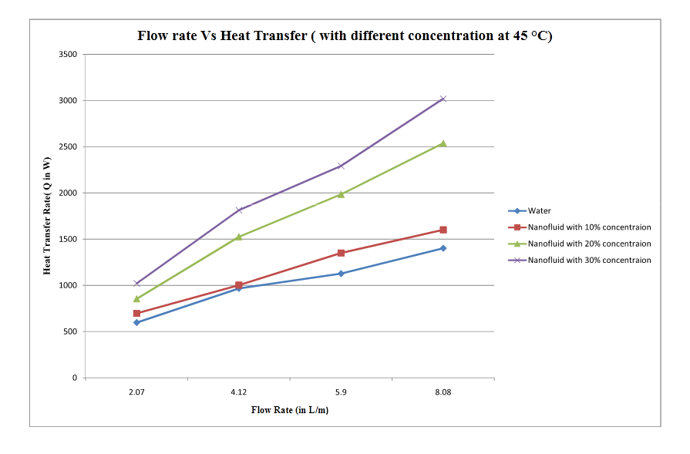
Fig 8. Flow Rate vs Heat Transfer (with different conc. At 45°C)
Relationship between flow rate and heat transfer rate and shows variation of heat transfer rate with different flow rate at different concentrations of nanofluid is given in Fig 8. With Increase in different concentration and flow rate, heat transfer rate also increases at fixed temp 45°C. In the graph nanofluid is having better heat transfer rate.

Slide 33
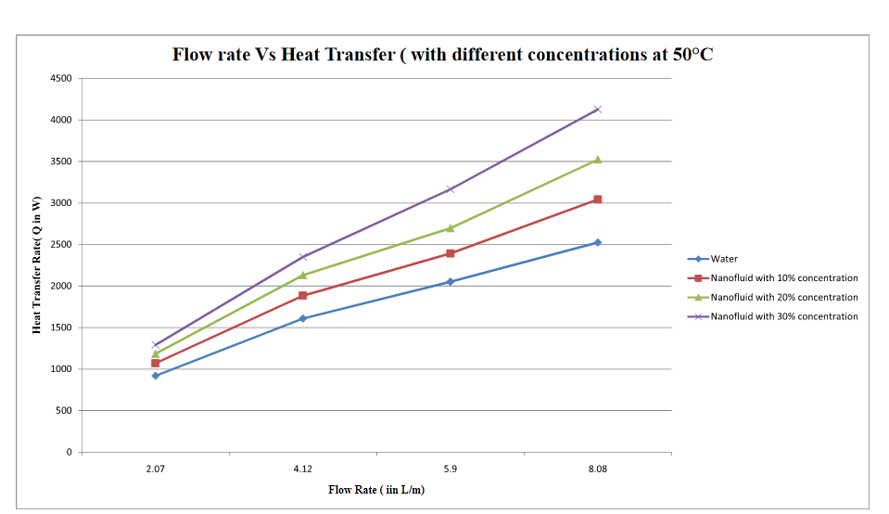
Fig 9. Flow Rate vs Heat Transfer (with different conc. At 50°C)
Fig 9 relates between flow rate and heat transfer rate and shows variation of heat transfer rate with different flow rate at different concentrations of nanofluid. With Increase in different concentration and flow rate, heat transfer rate also increases at fixed temp 50°C. In the graph nanofluid is having better heat transfer rate.

Slide 34
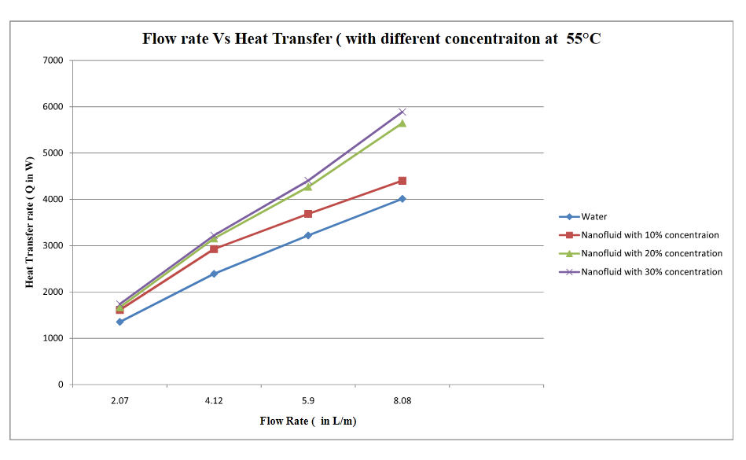
Fig 10. Flow Rate vs Heat Transfer (with different conc. At 55°C)
Fig 10 relates between flow rate and heat transfer rate and shows variation of heat transfer rate with different flow rate at different concentrations of nanofluid. With the Increase in different concentration and flow rate, heat transfer rate also increases at fixed temp 55°C. In the graph nanofluid is having better heat transfer rate.

Slide 35
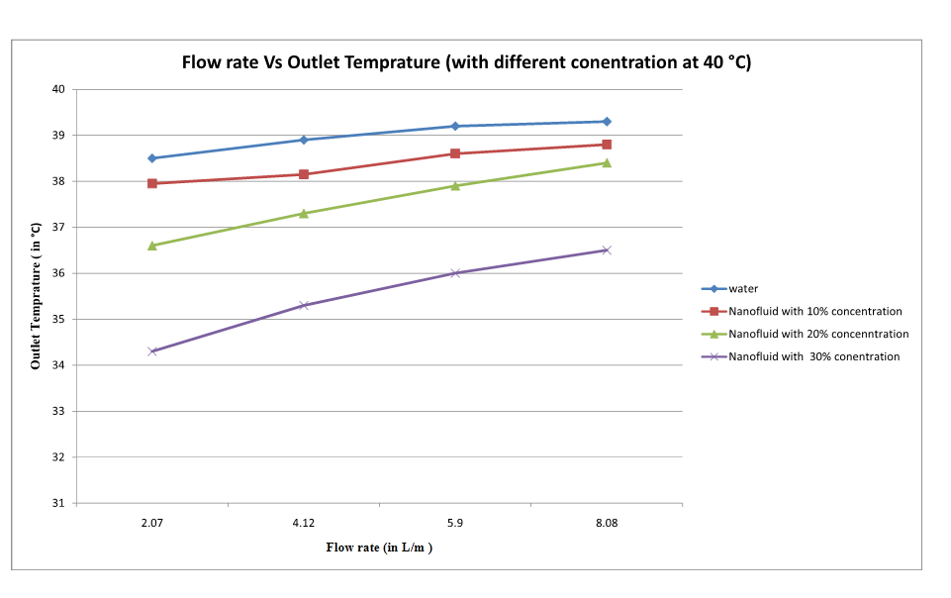
Fig 11. Flow Rate vs Outlet Temprature (with different conc. At 40°C)
Fig 11 shows relationship between flow rate and outlet temperature with different flow rate at different concentration of nanofluid. At a constant inlet temperature of 40 °C, the temperature difference between the inlet and outlet decreases with an increase in flow rate for all conc. Also, the decrease in outlet temperature is maximum for 30% and minimum for water at all inlet temperatures.

Slide 36
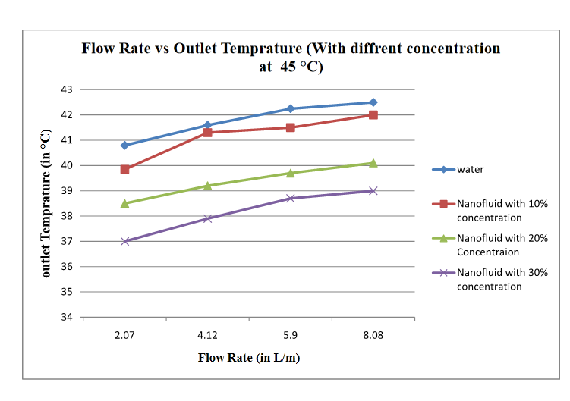
Fig 12. Flow Rate vs Outlet Temprature (with different conc. At 45°C)
Fig 12 shows relationship between flow rate and outlet temperature with different flow rate at different concentration of nanofluid. At a constant inlet temperature of 45 °C, the temperature difference between the inlet and outlet decreases with an increase in flow rate for all conc. Also, the decrease in outlet temperature is maximum for 30% and minimum for water at all inlet temperatures.

Slide 37
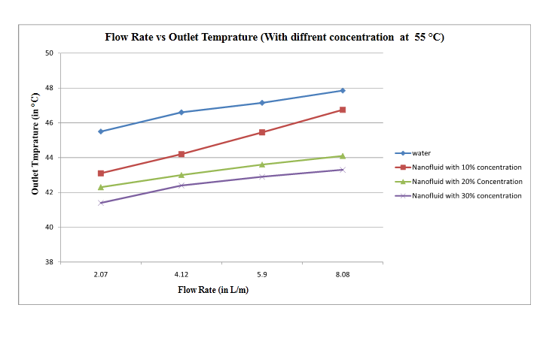
Fig 13. Flow Rate vs Outlet Temprature (with different conc. At 55°C)
Fig 13 shows relationship between flow rate and outlet temperature with different flow rate at different concentration of nanofluid. At a constant inlet temperature of 55 °C, the temperature difference between the inlet and outlet decreases with an increase in flow rate for all conc. Also, the decrease in outlet temperature is maximum for 30% and minimum for water at all inlet temperatures.

Slide 38
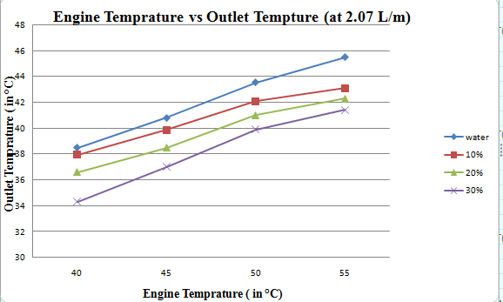
Fig 14. Engine Temprature vs Outlet Temprature (at 2.07 l/m)
Fig 14 shows relation between engine temperature and outlet temperature at different concentration of nanofluid at a fixed flow rate. At a constant flow rate of 2.07 l/m, outlet temperature decreases with an increase in inlet temperature for all concentrations. Also, the decrease in outlet temperature is maximum for 30% and minimum for water at all inlet temperatures.

Slide 39
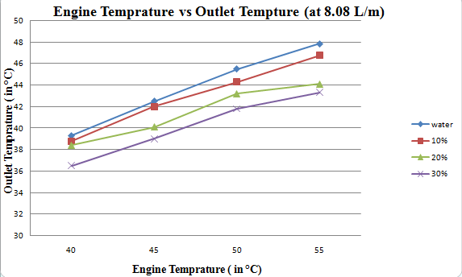
Fig 15. Engine Temprature vs Outlet Temprature (at 8.08 l/m)
Fig 15 shows relation between engine temperature and outlet temperature at different concentration of nanofluid at a fixed flow rate. At a constant flow rate of 8.08 l/m, outlet temperature decreases with an increase in inlet temperature for all concentrations. Also, the decrease in outlet temperature is maximum for 30% and minimum for water at all inlet temperatures.

Slide 40
CONCLUSION
The Experimental study was done on the radiator vehicle at different concentrations of nanofluid (form 10% to 30%) and different engine temperature (40 to 55°C) to evaluate the outlet temperature of fluid and heat transfer by the fluid at different flow rate of the coolant with constant air flow rate .
Key conclusions are as follows:-
The outlet temperature of the coolant decreases with increase concentration of nanofluid. Higher temperature as observed in water and lowest temperature found in30%of the coolant at different flow rate and engine temperature.
The heat transfer rate of the radiator increases by the coolant and maximum heat transfer rate is found at 30% concentration of nanofluid for all flow rate and engine temperature.
The heat transfer rate increases by increasing concentration of coolant because of increasing the thermal conductivity of the fluid.

Slide 41
References
[1]. Yu, W., France, D. M., Choi, S. U., & Routbort, J. L. (2007). Review and assessment of nanofluid technology for transportation and other applications (No. ANL/ESD/07-9). Argonne National Lab.(ANL), Argonne, IL (UnitedStates).
[2]. Leong, K.Y., Saidur, R., Kazi, S.N. and Mamun, A.H., 2010. Performance investigation of an automotive car radiator operated with nanofluid-based coolants (nanofluid as a coolant in a radiator). Applied Thermal Engineering, 30(17-18), pp.2685-2692.
[3]. Peralta-Videa, J.R., Zhao, L., Lopez-Moreno, M.L., de la Rosa, G., Hong, J. and Gardea-Torresdey, J.L., 2011. Nanomaterials and the environment: a review for the biennium 2008–2010. Journal of hazardous materials, 186(1), pp.1-15.
[4]. Chavan, D. and Pise, A.T., 2014. Performance investigation of an automotive car radiator operated with nanofluid as a coolant. Journal of Thermal Science and Engineering Applications, 6(2), p.021010.
[5]. Sidik, N.A.C., Yazid, M.N.A.W.M. and Mamat, R., 2015. A review on the application of nanofluids in vehicle engine cooling system. International Communications in Heat and Mass Transfer, 68, pp.85-90.
[6]. Shirvan, K.M., Mirzakhanlari, S., Kalogirou, S.A., Öztop, H.F. and Mamourian, M., 2017. Heat transfer and sensitivity analysis in a double pipe heat exchanger filled with porous medium. International Journal of Thermal Sciences, 121, pp.124-137.
[7]. Pandya, N.S., Shah, H., Molana, M. and Tiwari, A.K., 2020. Heat transfer enhancement with nanofluids in plate heat exchangers: A comprehensive review. European Journal of Mechanics-B/Fluids, 81, pp.173-190.

Slide 42
[8]. Ajeeb, W., da Silva, R.R.T. and Murshed, S.S., 2023. Experimental investigation of heat transfer performance of Al2O3 nanofluids in a compact plate heat exchanger. AMert, S., Yasar, H., Durmaz, U., Topuz, A., Yeter, A. and Engin, T., 2021. An experimental study on cooling performance of a car radiator using Al2O3-ethylene glycol/water nanofluid. Thermal Science, 25(1 Part B), pp.801-809.
Applied Thermal Engineering, 218, p.119321.
[9]. Manna, I., 2009. Synthesis, characterization and application of nanofluid—an overview. Journal of the Indian Institute of Science, 89(1), pp.21-33.
[10]. Elias, M.M., Mahbubul, I.M., Saidur, R., Sohel, M.R., Shahrul, I.M., Khaleduzzaman, S.S. and Sadeghipour, S., 2014. Experimental investigation on the thermo-physical properties of Al2O3 nanoparticles suspended in car radiator coolant. International Communications in Heat and Mass Transfer, 54, pp.48-53.
[11]. Sharma S, Garg H. Criticality of nanofluids: an overview. In: Proceedings of the 1st recent advances in mechanical engineering (RAME2017), Panipat, India, 17th, 18th March, 2017; Vol. No. 1, pp. 49–56.

Slide 43


